Slide 1
On Demand Car Wash Platform
Prepared By
Korrai Bhargav
Vutukuri Naga Venkata kasi Amarnadh kumar
Imam Gouse Peddarumala shaik
Sujeet Kumar
Jami mutyalarao
Sudesh K
Adrija Biswas
Priyank Joshi
Neetu kumari
Durgesh kumar

Slide 2
Table of Contents:
Introduction
Problem Statement
Proposed System
Technologies
Use Case Diagrams
Sequence Diagram For Customer
Sequence Diagram For Admin
Sequence Diagram For Washer
Technology Used
Output Diagram
Conclusion
References

Slide 3
Introduction
You can get your car washed wherever you are at your convenience. Whether it's your home, salon, office or any other place, your car wash is just a few taps away. Few moments spend in signup can save your valuable time. All you need to do is just enter your car, address, and payment details. A washer will come at your location and give your car a premium wash. The app also contains various packages and add-ons to wipe, clean and dress your entire car from inside out

Slide 4
Problem Statement
Today, with the changing preferences and growing income, people are likely to roam around in sedans and SUV's. With the increasing car consumer market, car wash segment is all set to join the race. Forecasting the expanding markets of the car care services, Green Carwash company approached Hyperlink Info System to develop an interface that connects customers and service providers to avail the best wash services within the nearest proximity. The main aim of the client is to explore the untapped market opportunities by satisfying increasing consumer demands through professional car wash services. The app is developed on Android platforms and designed for the USA audience only.

Slide 5
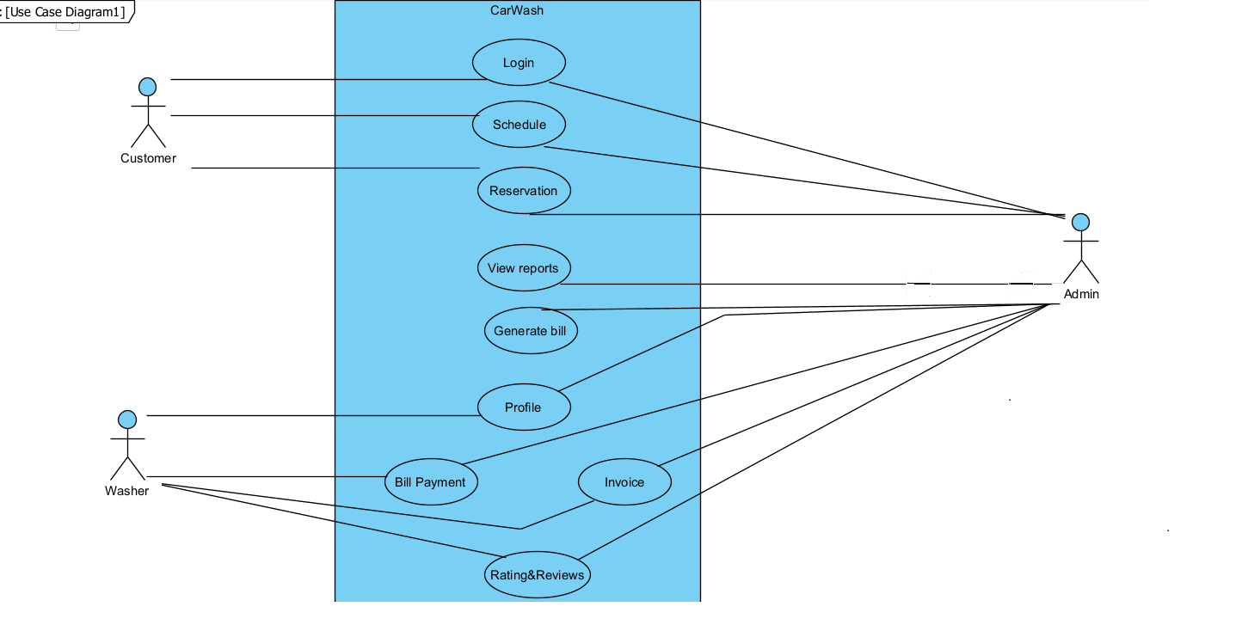
Use Case Diagram

Slide 6
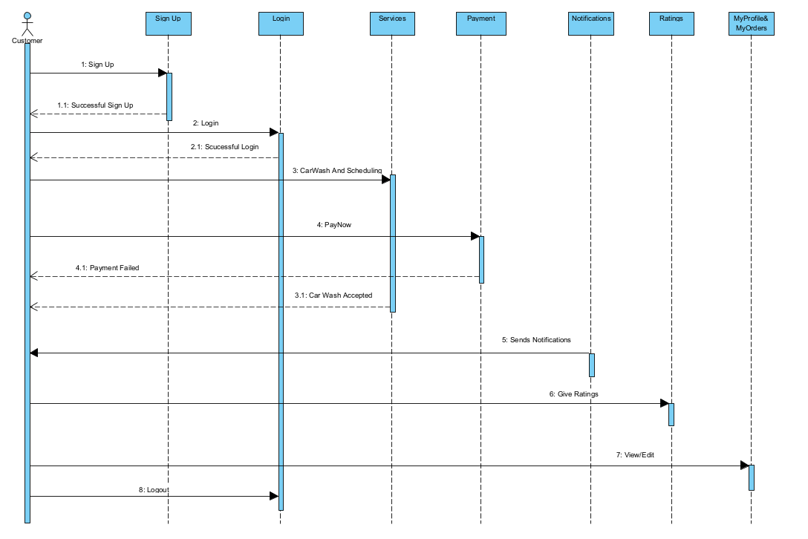
Sequence Diagram For Customer

Slide 7
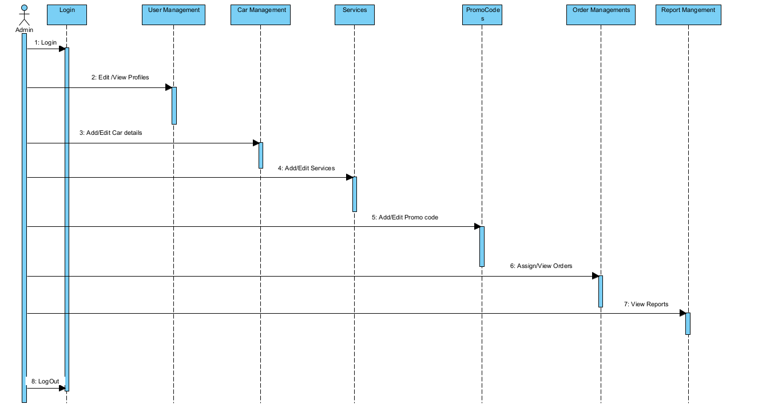
Sequence Diagram For Admin

Slide 8
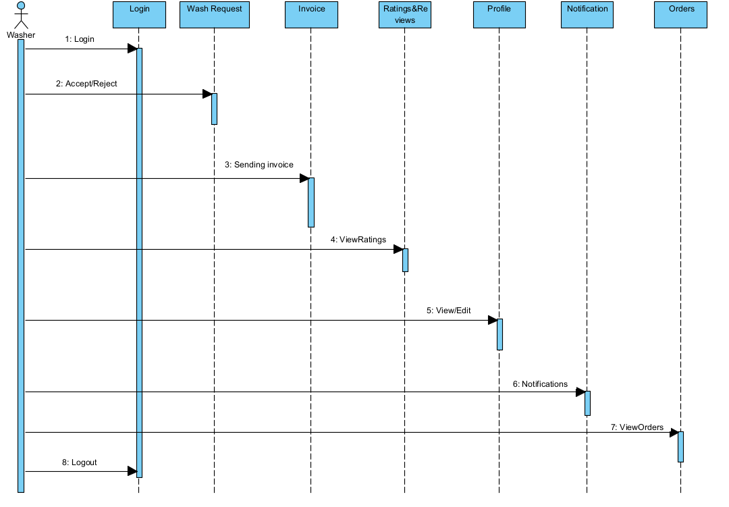
Sequence Diagram For Washer

Slide 9

Technology used for implementation
Front-End: html5, CSS3, Angular
Database: SQL Server
Back-End: Asp.net Core Web API
Browser Compatibility: All Browser Compatible

Slide 10
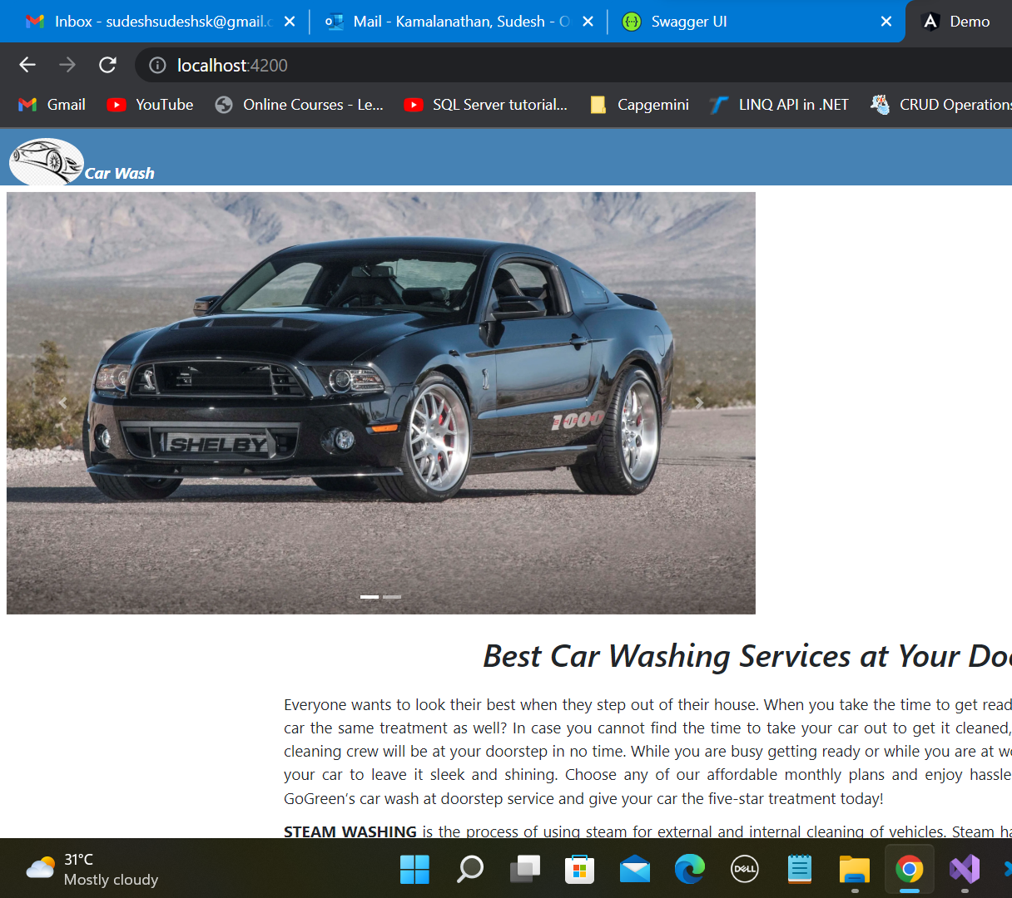
Home Page

Slide 11
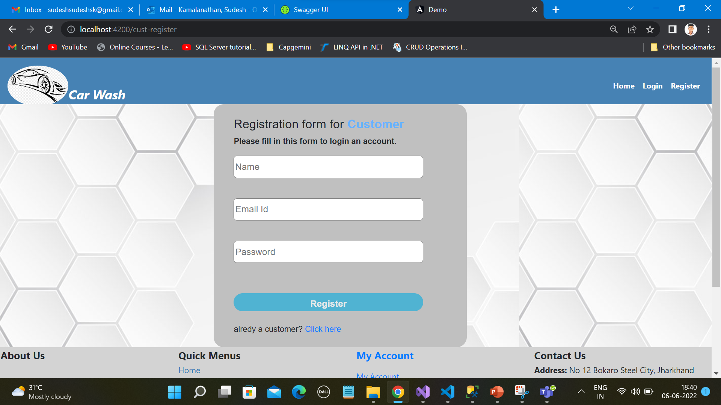
Customer Registration Page

Slide 12
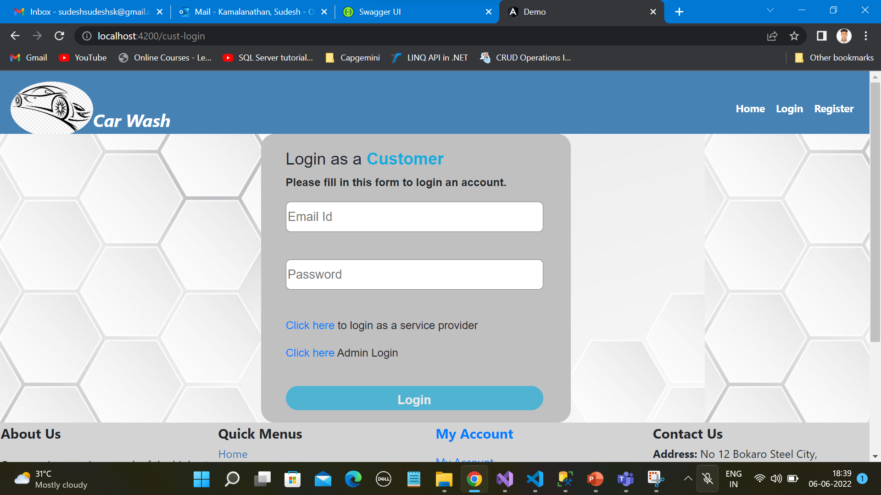
Customer Login

Slide 13
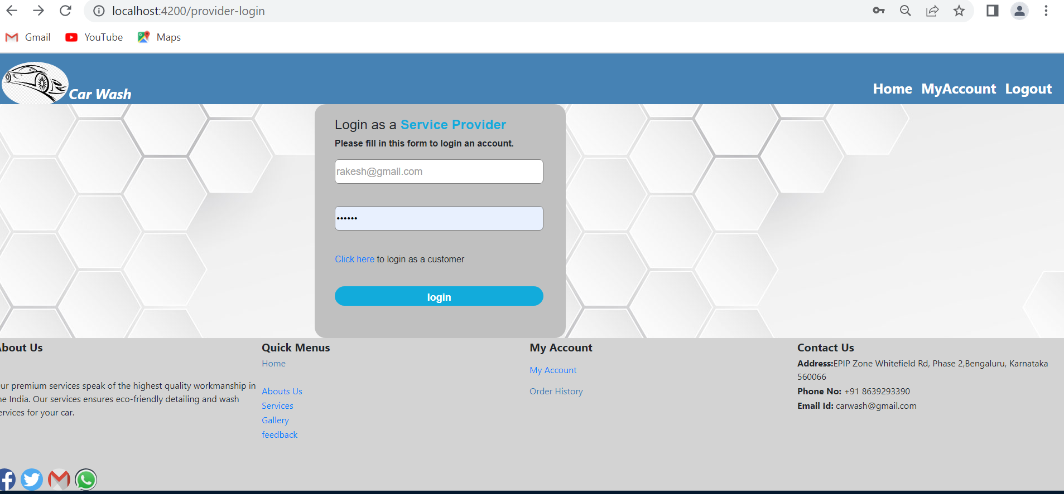
Washer login

Slide 14
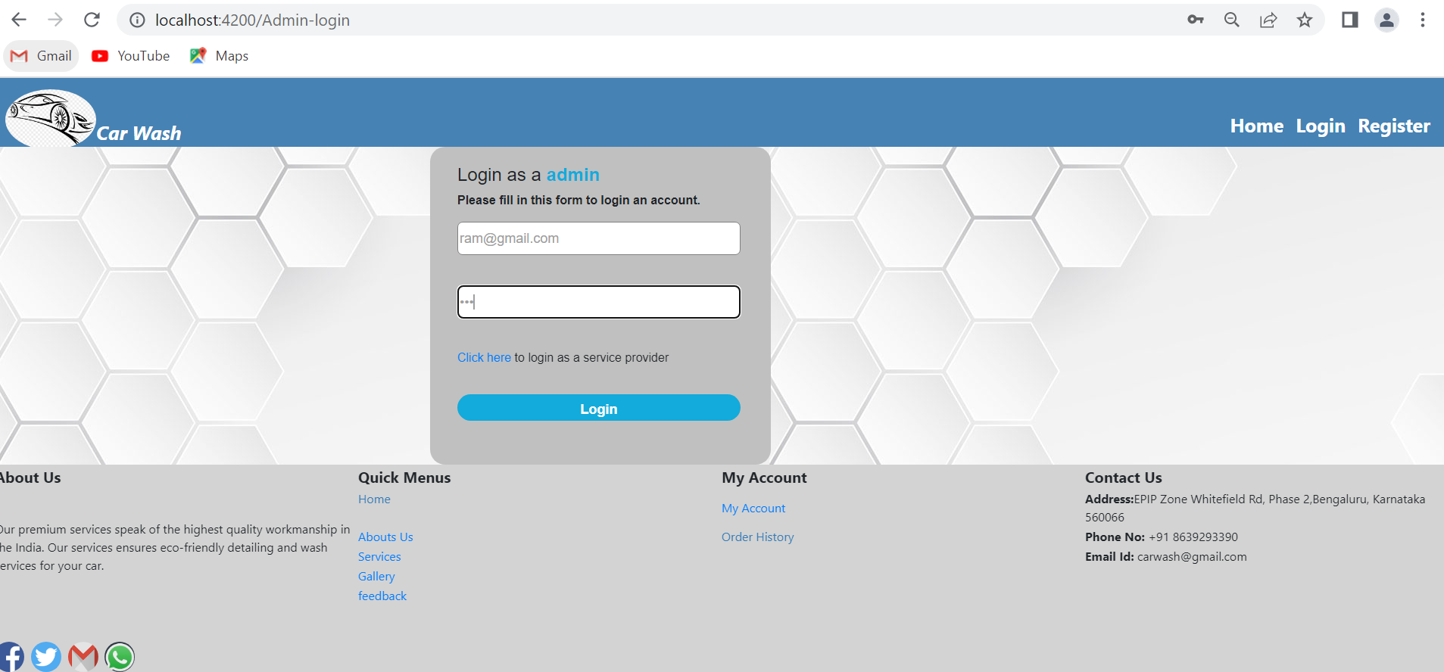
Admin Login

Slide 15
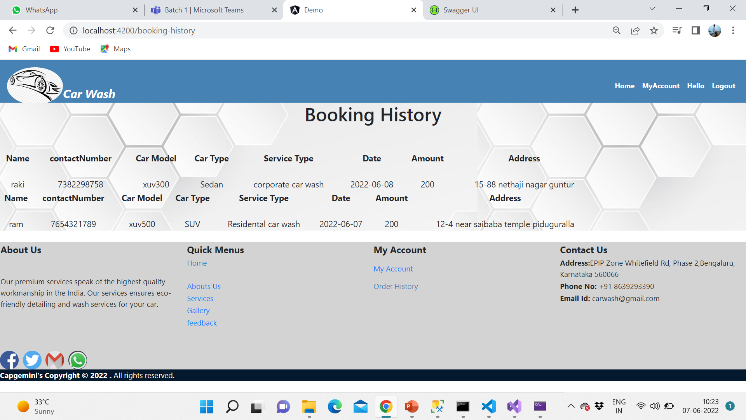
Booking History Page

Slide 16
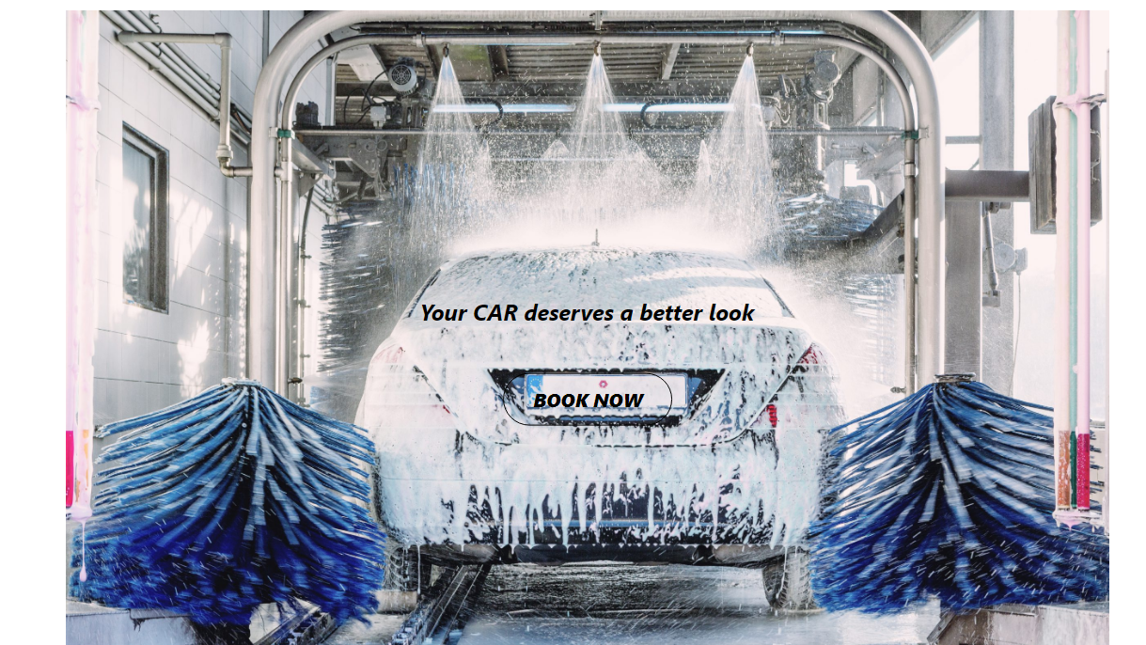

Slide 17
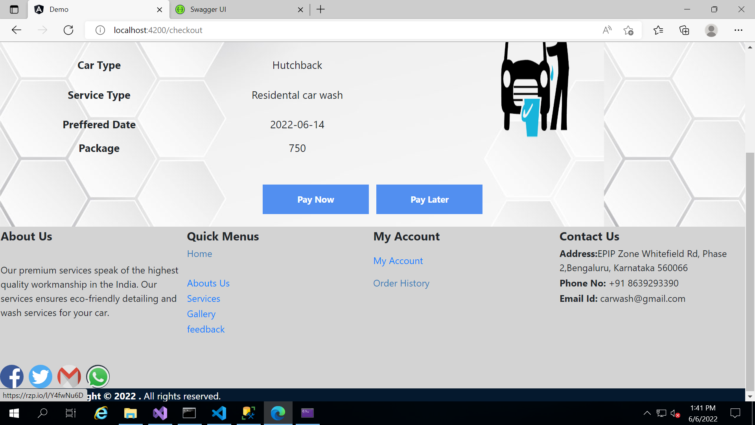
Payment Page
Click on Pay Now button for online payment

Slide 18
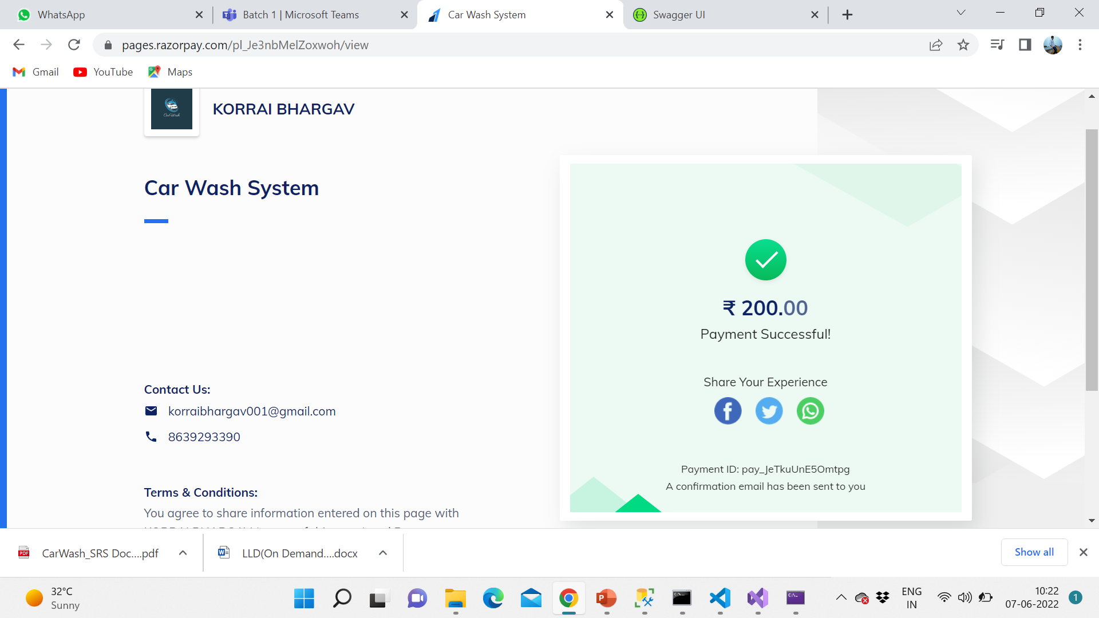
It will redirect you to RazorPay payment gateway

Slide 19
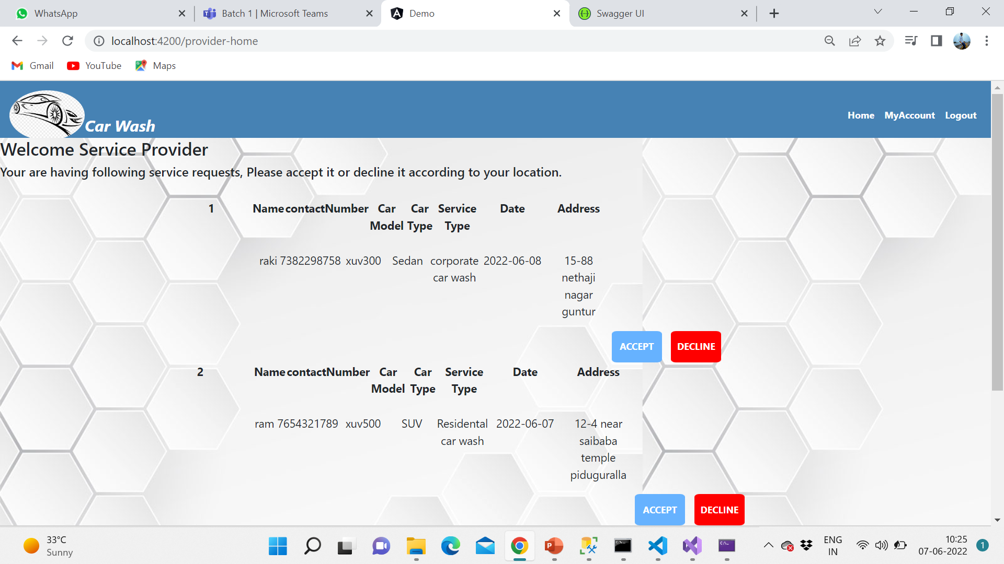
Accept and Reject page
After log in as a service provider a list of orders is displayed, You may accept or decline the order

Slide 20
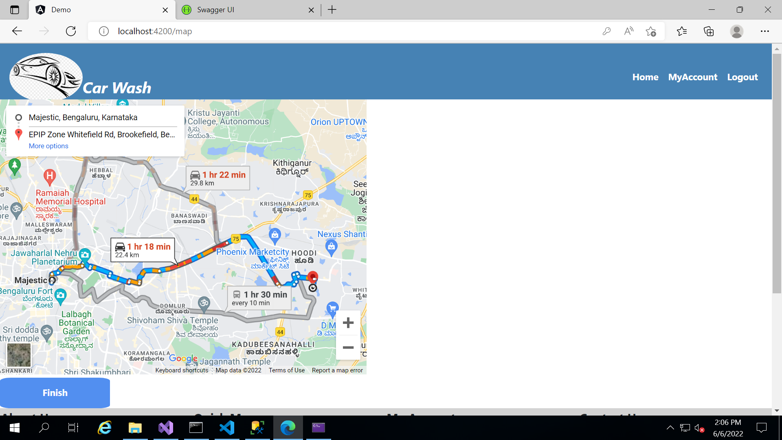
MAP Display Location
After accepting an Order the address of Customer will be Displayed Here

Slide 21
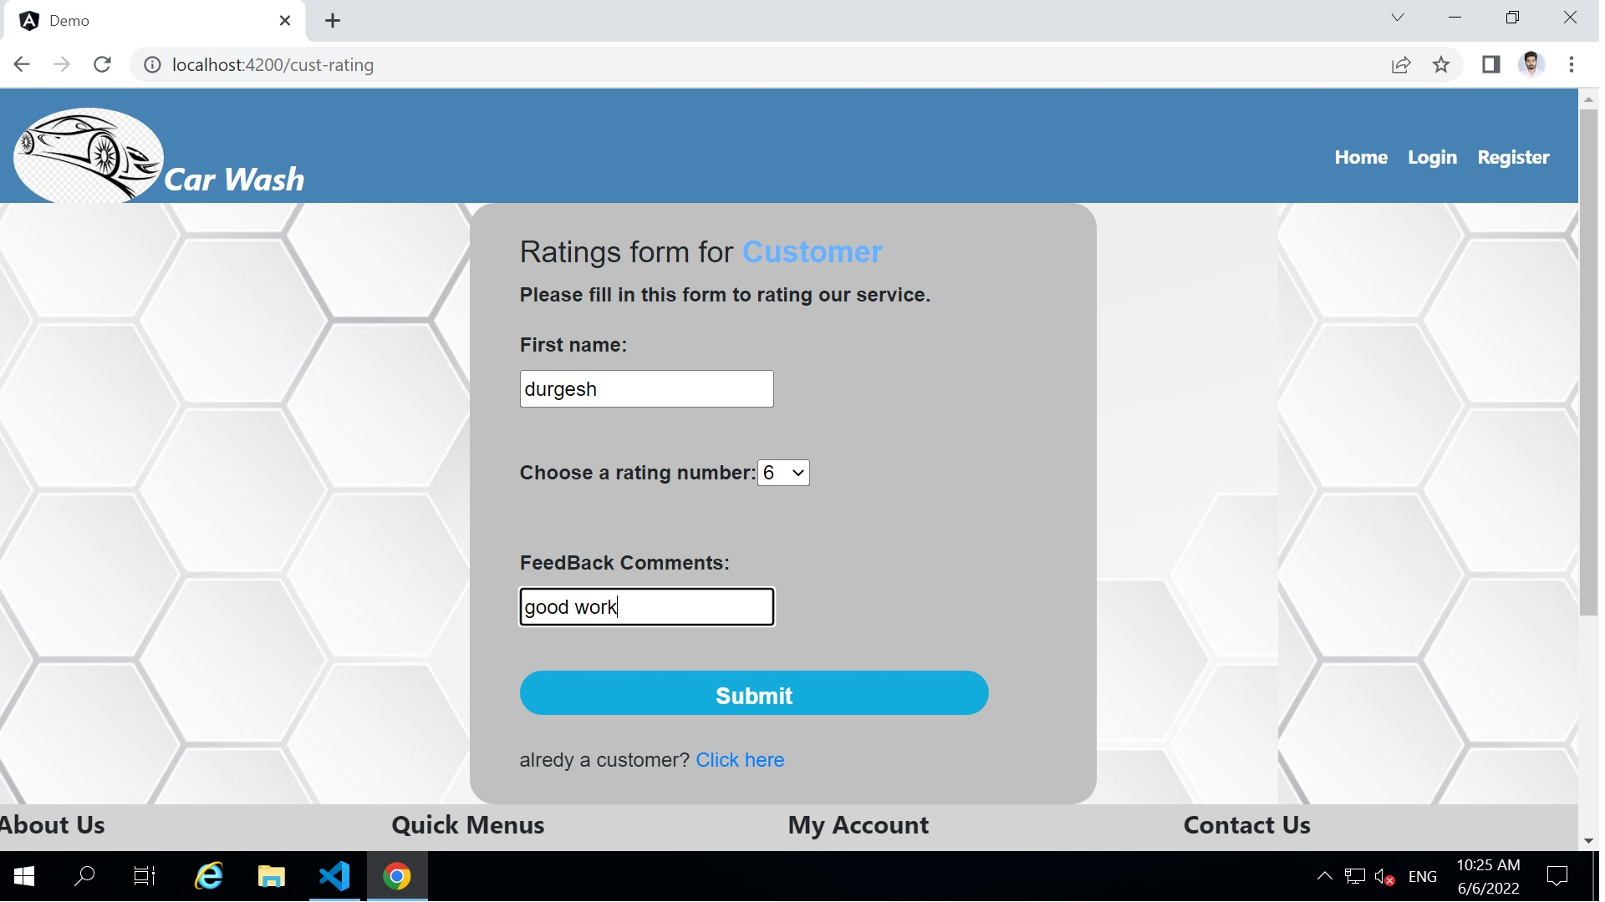
Customer Feedback

Slide 22

Conclusion
The Main Objective of this Project to flexible the Car Wash . Whether it's your home, salon, office or any other place, your car wash is just a few taps away. Few moments spend in signup can save your valuable time. All you need to do is just enter your car, address, and payment details. A washer will come at your location and give your car a premium wash.

Slide 23
References
https://www.w3schools.com/html/
https://www.w3schools.com/w3css/
https://www.w3schools.com/js/
https://codewithmosh.com/p/the-ultimate-typescript
https://programmingwithmosh.com/angular/
https://www.tutorialsteacher.com/webapi
https://www.pluralsight.com/paths/aspnet-core
https://codewithmosh.com/p/entity-framework
http://www.softwaretestinghelp.com/
https://www.guru99.com/
https://www.geeksforgeeks.org/

Slide 24
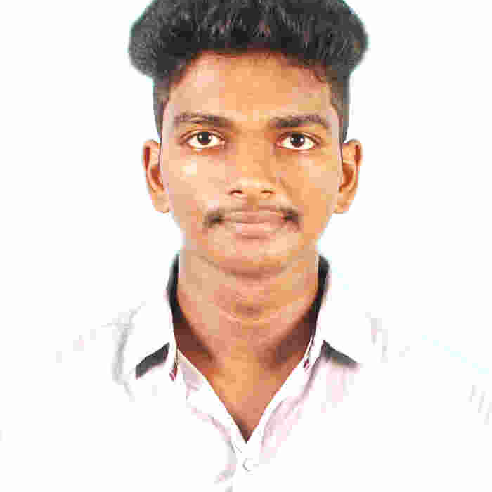



Sudesh Kamalanathan
Analyst/Software Engineer
Bachelor of Engineering, Computer Science and Engineering : 2016 - 2020
Skills
C# | C#Basics,OOPS,Generics, Collections, Array,Loops,LINQ
.NET | ADO.NET,ASP.NET with MVC5 and WEB API,Entity Framework
Angular | Components, Services, Modules, Routing, Forms & Validation
Database | Microsoft SQL Server
UI Tech | HTML 5 & CSS 3,JavaScript, ES6 & TypeScript ,Optimized UI Designed,Bootstrap
Tools | Git, PostMan,SSMS,Visual Studio, Visual Studio Code
Add On skills | Immersive Learning
Bangalore
Sudesh.kamalanathan@capgemini.com
+91 9789894419
A4
Full Stack Developer
Hands on experience on C#,ADO.NET,LINQ,Entity framework,Sql Server,ASP.NET MVC5 with WEB API
Full Stack developer with Angular and Full Stack .NET Developer
Proficient in creating Single page Web Application in Angular with Authentication with routing.
Hands on experience in developing web pages using HTML5, CSS3, Object Oriented Java script, TypeScript, ES6, JSON, XML. Good understanding of Document Object Model (DOM) and DOM Functions.
Knowledge on SSMS and Git
Car Wash Management System [ Video Profile]
Case study of Car Wash Management System along with API Gateway, Swagger and payment , responsive UI with HTML5, CSS, Bootstrap and Angular used as User Interface.
Check out my work on GitHub

Slide 25


